Slide 1
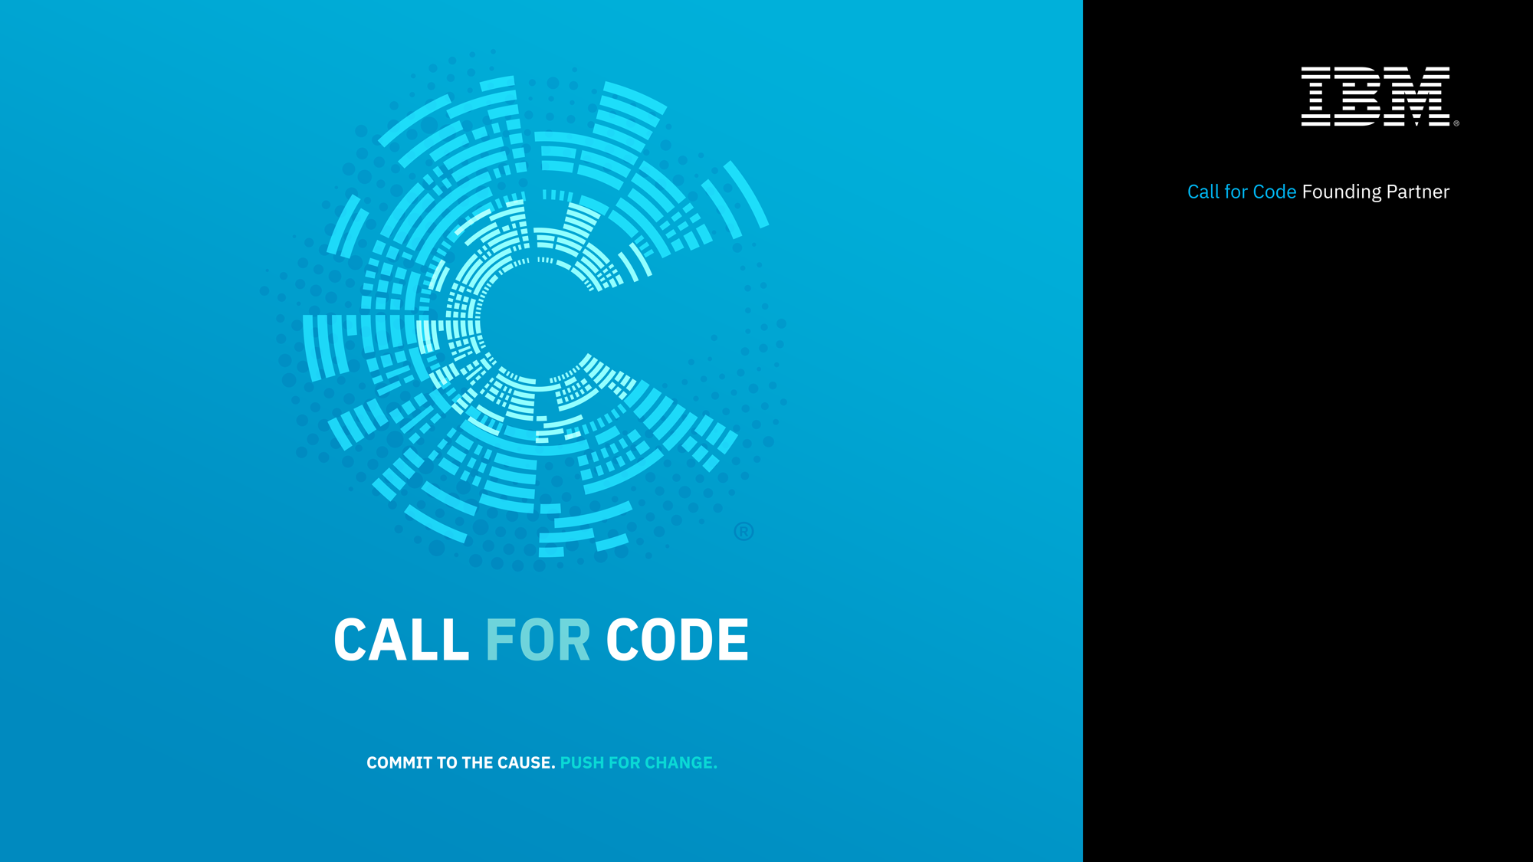
CALL FOR CODE REGISTRATION GUIDE

Slide 2
Register for Call for Code
Invitation from Call for Code Slack Channel
Join IBM Coder Platform
Sign Up for IBM Cloud Account
Start building for Call for Code Challenge
Registration open till 31st August 2018
Submission before 31st August 2018

Slide 3
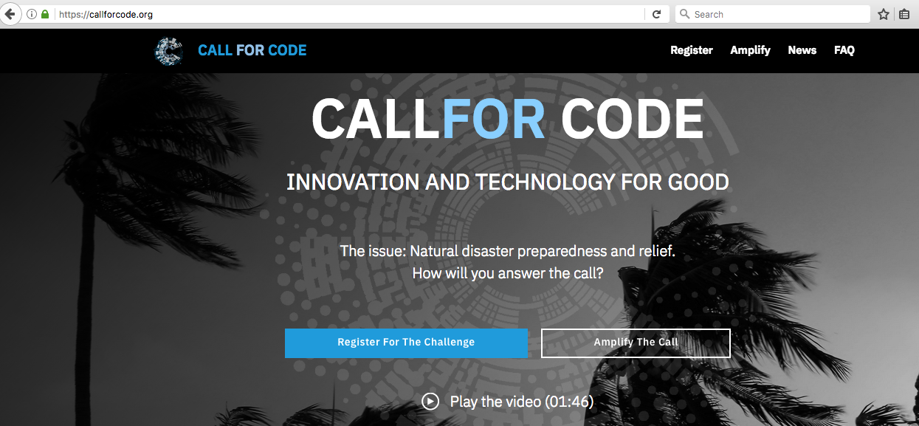
Register for Call for Code: https://callforcode.org/

Slide 4
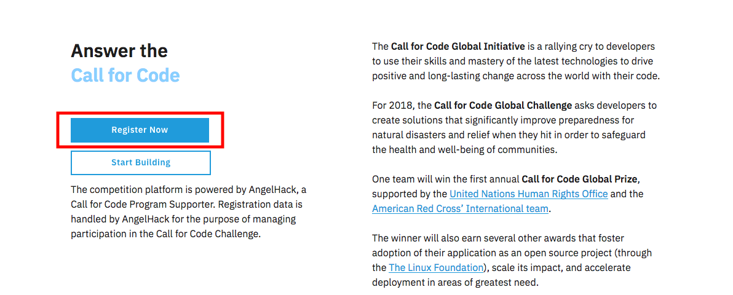
Click on Register Now

Slide 5
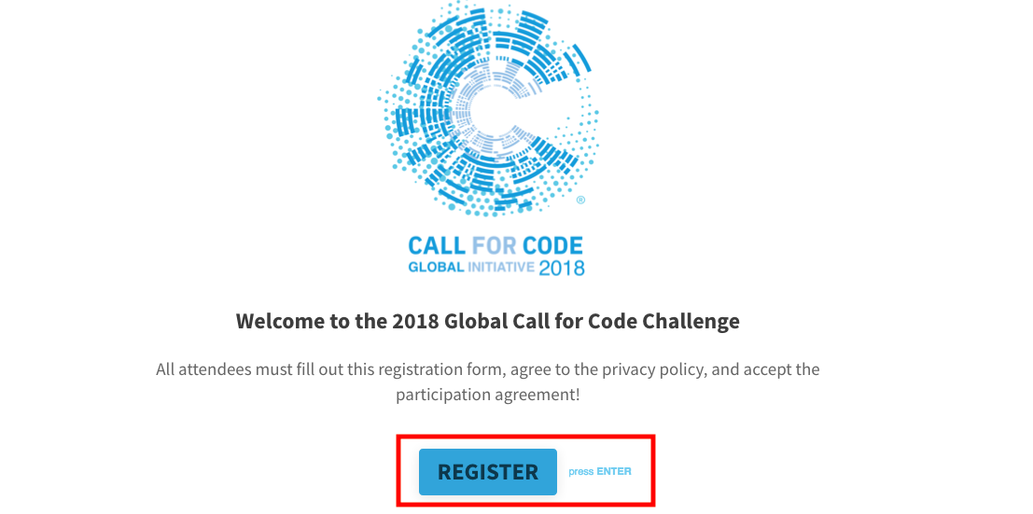
Click on REGISTER and enter your details

Slide 6
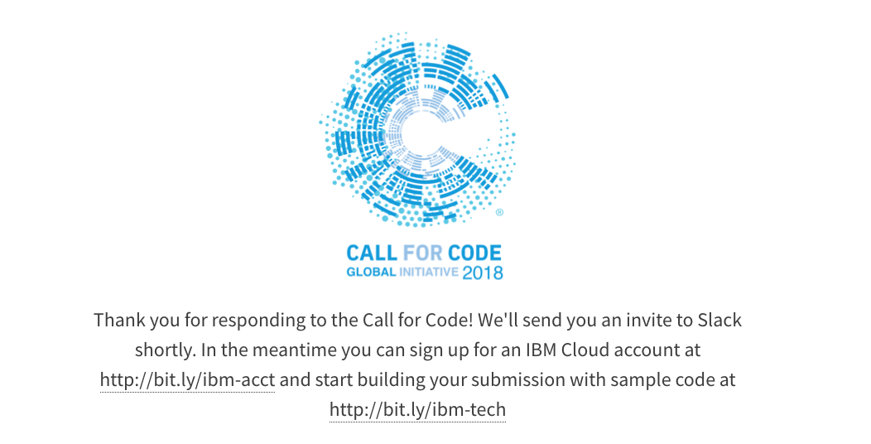
After registering, you will be redirected to page with all the relevant links

Slide 7
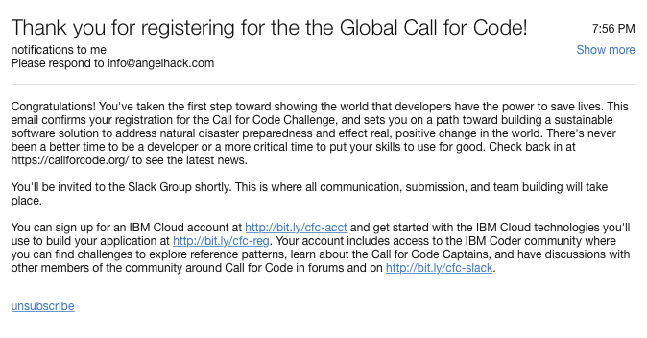
You will also receive a Thank you mail

Slide 8
SLACK CHANNEL
You will receive an invitation from Call for Code Slack Channel where you can have discussions with other members of the community and also developer advocates to solve technical challenges-
http://bit.ly/cfc-slack

Slide 9
IBM CODER PLATFORM
Join IBM Coder Platform, where you can find challenges to explore reference patterns, learn about the Call for Code Captains, form teams and have discussions with other members of the community.
https://ibmcoders.influitive.com

Slide 10
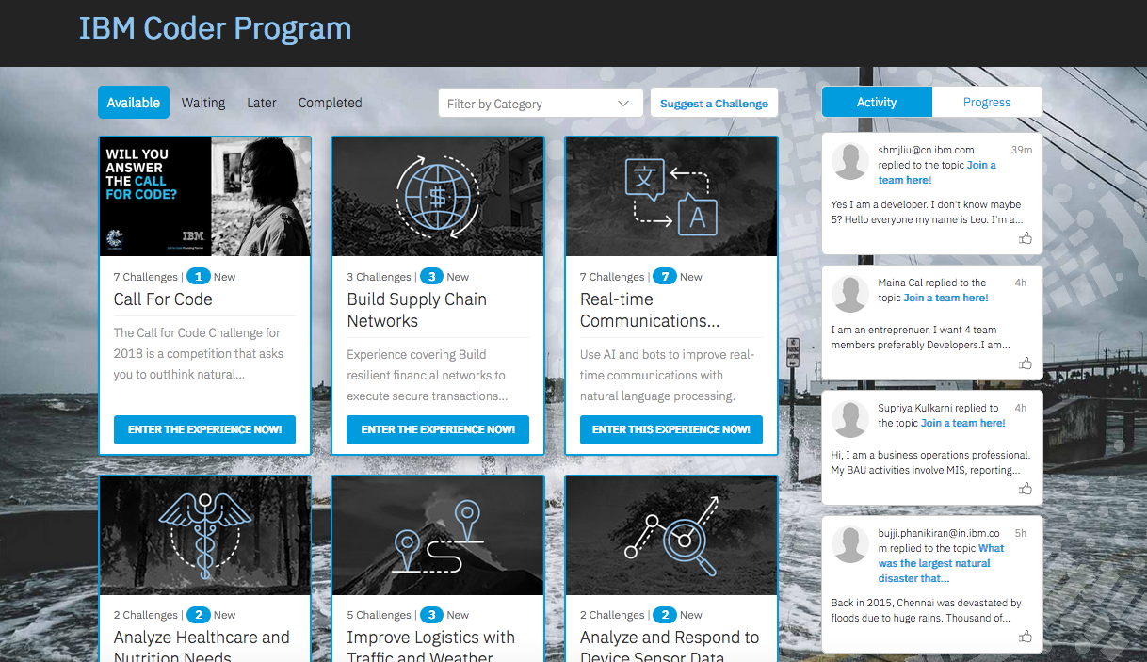

Slide 11
IBM CLOUD REGISTRATION
Sign up for an IBM Cloud account at
https://bit.ly/ibm-acct

Slide 12
SUBMISSION PAGE FOR CALL FOR CODE WILL BE ROLLED OUT SOON. STAY TUNED. THANK YOU !

